Slide 1
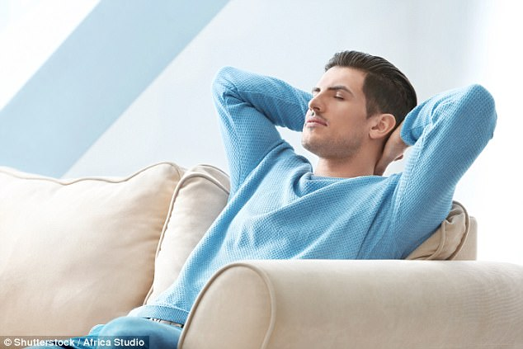
Leisure Time

Slide 2
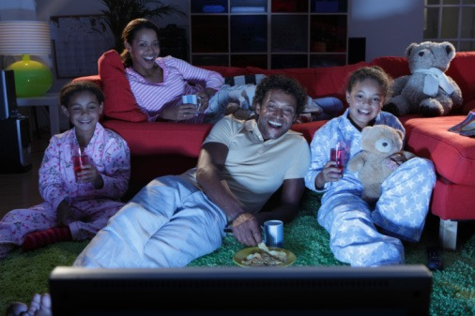
Leisure Time Study Unit Lesson 1. What is Leisure Time? Lesson 2. Benefits of recreation participation in leisure time Lesson 3. psychological benefits of recreation activity in leisure time Lesson 4. How to spend leisure time?

Slide 3
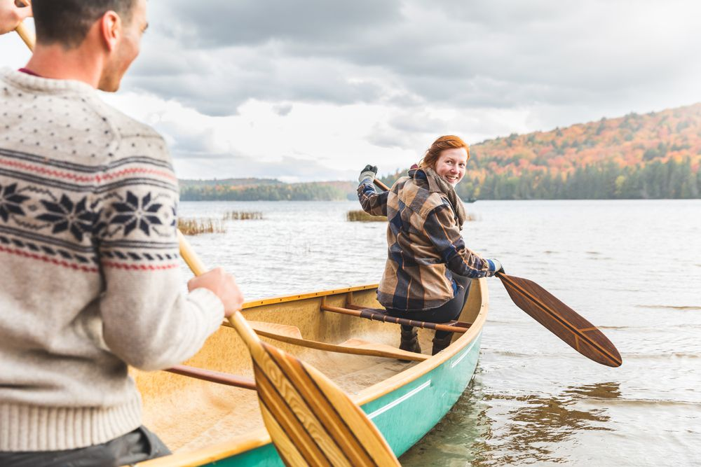
Leisure Time
What is Leisure
Leisure is that time free from demands of school, work, or required activities of daily living.
Everyone needs regular recreation that develops skills, promotes good health, relieves stress, facilitates social interactions, and provides a general joy for living.

Slide 4
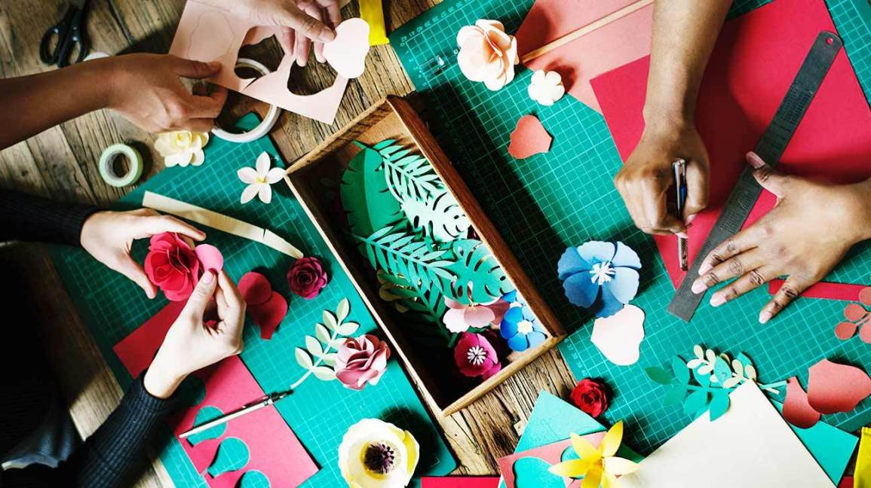
Leisure Time
What is Leisure
For recreation, we choose activities at which we can be successful. Good readers read. Athletes seek sports' activities.
Craftspeople create. Social individuals engage in group activities.
Musicians lose themselves in music. Visual artists paint or draw.
Observers appreciate the efforts of others - whether a basketball game, painting, fine meal, or concert.

Slide 5

Leisure Time
What is Leisure
Children, ‘ado’lescents, and adults with learning special needs may find themselves with limited opportunities to fully enjoy leisure time.
A lack of perceptual, motor, memory, linguistic, or organizational skills may cause us as much difficulty for leisure as we have at school or work.

Slide 6
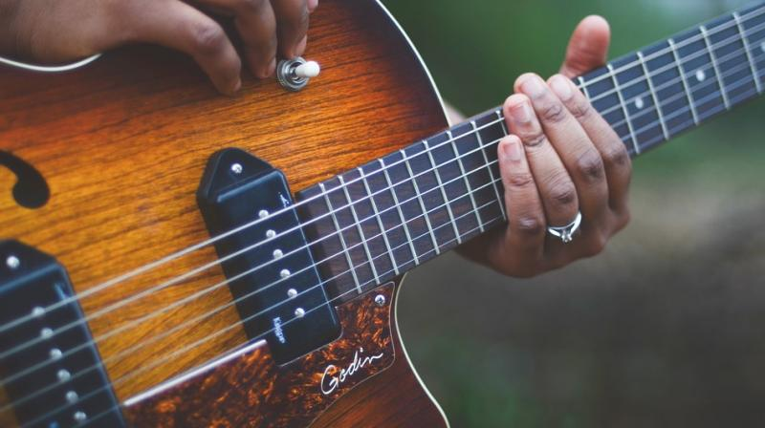
Leisure Time
What is Leisure
Just as we are teach with dyslexia(dis’lesia) to read, those with math disabilities to understand math, those with linguistic problems to better comprehend and use language, we must teach skills and provide practice so individuals with learning with special needs can achieve some recreational proficiencies.

Slide 7

Leisure Time
What is Leisure
Why should we engage in recreation activities in leisure time?
Simply because they can derive many benefits from recreation participation.
One benefit is learning from the experience.

Slide 8
Sandra
Davianna
Exercise: choose what you do in your leisure time
Matthew
Reading
Listen to Music
Sandra
Matthew
Sandra
Matthew
Matthew
Art Crafts
Play Sports
Andrew
Davianna
Davianna
Davianna
Davianna
Davianna
Davianna
Matthew
Sandra
Sandra
Matthew
Social Interactions
Watch Movies
Indira
Matthew
Evanna

Slide 9
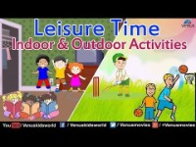

Slide 10
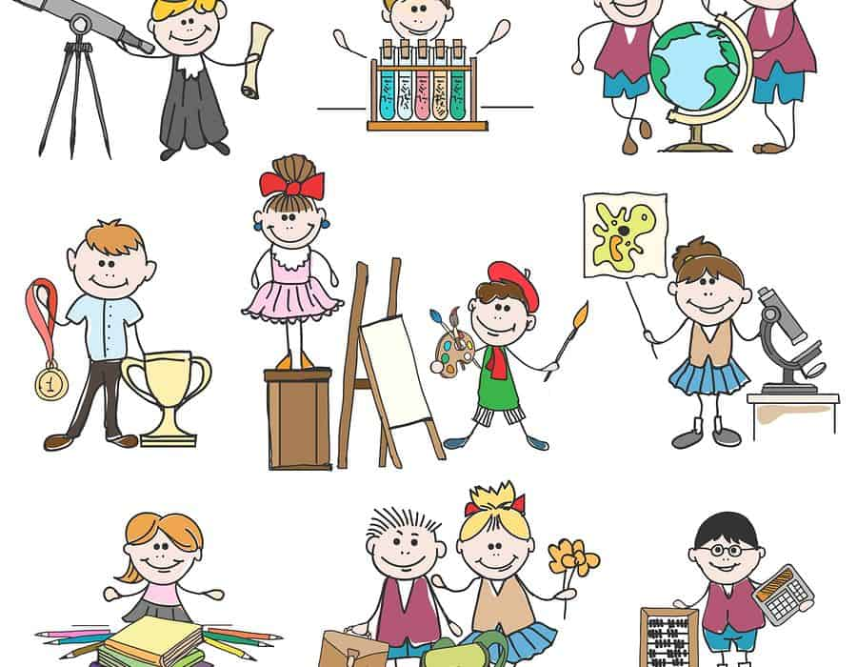
Leisure Time
Benefits of recreation participation
Why should a person with learning special needs engage in recreation activities? Simply because they can derive many benefits from recreation participation.
One benefit is learning from the experience. When the recreation activity experience has captivated the participant, this individual brings personality styles of learning, motivation, and expectations about the experience to the setting.

Slide 11
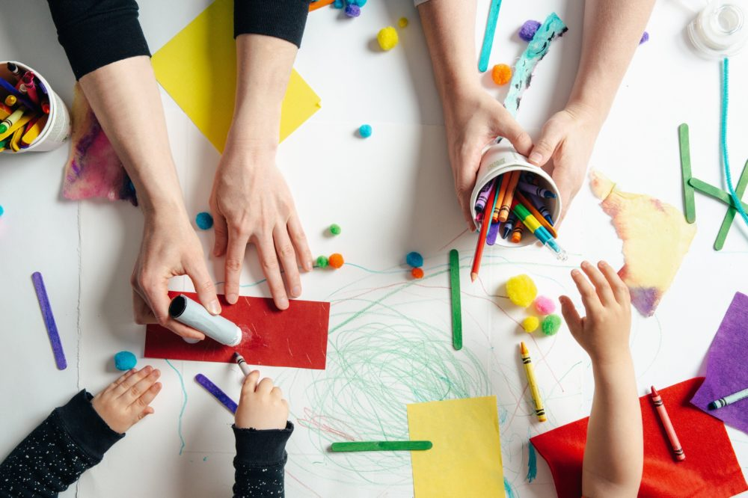
Leisure Time
Benefits of recreation participation
These experiences may come from involvement in a structured recreation program and may be exhibited as part of the information outcomes of participation.
Researchers in the field of learning and educational psychology have discovered a variety of learning outcomes.

Slide 12
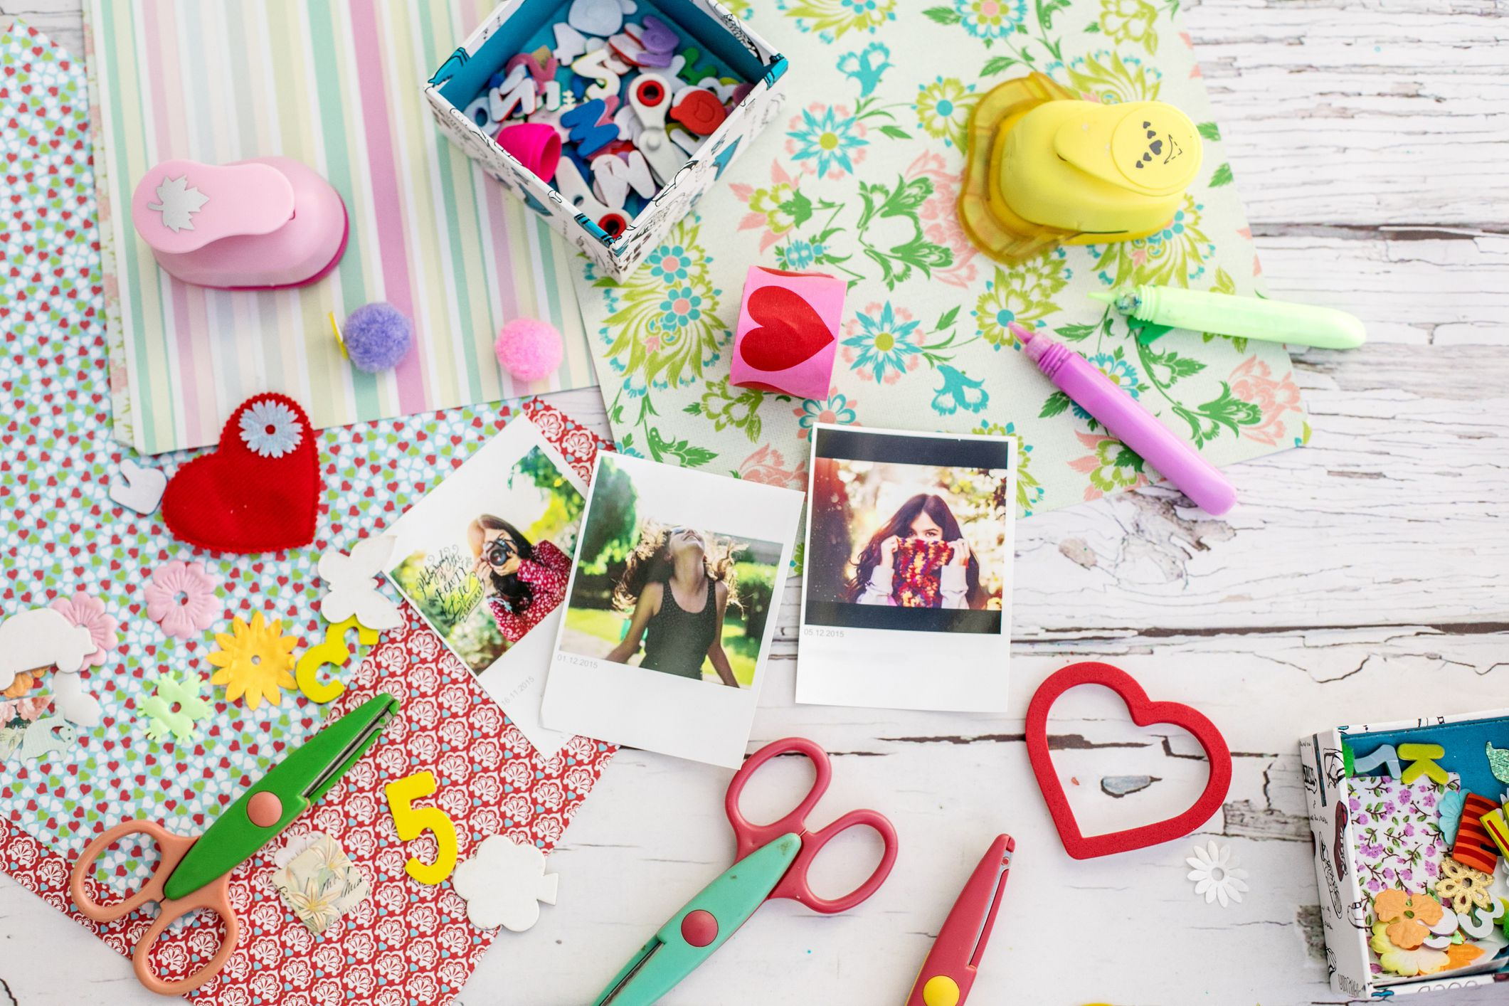
Leisure Time
Benefits of recreation participation
The following outcomes can be present because of participation in recreation activities: behavior change and skill learning, direct visual memory, information (factual) learning, concept learning, schemata (‘ski:merter)learning, meta’cog’nition learning and attitude, and value learning

Slide 13
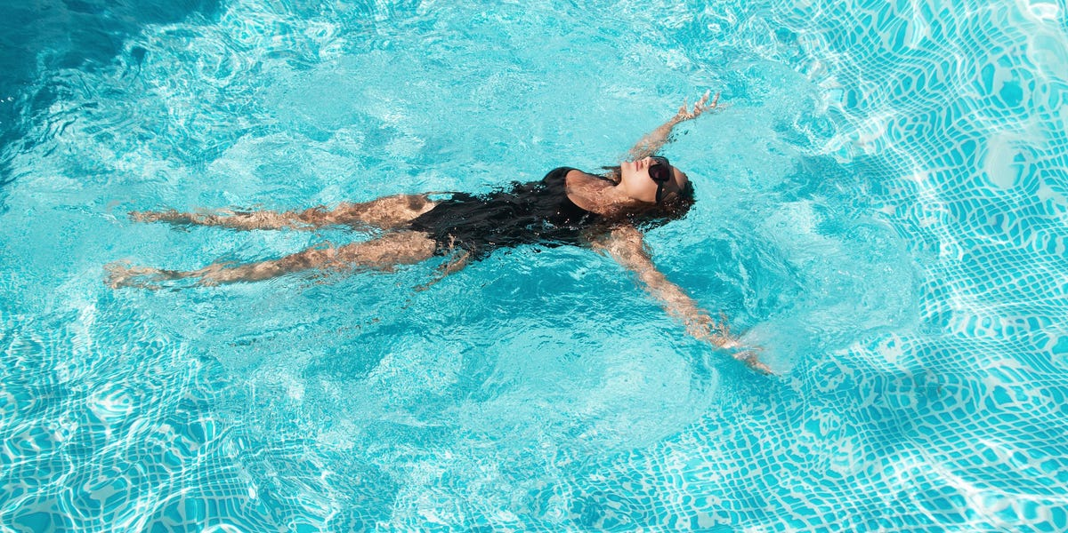
Leisure Time
Benefits of recreation participation
The physiological benefits of recreation participation were derived from studies where people engage in physical activity of some kind (e.g., exercise, cycling, swimming, walking, jogging, running, hiking, weightlifting, etc.).
Specific results from involvement in a physical recreation activity are an increased lung capacity, reduced resting heart rates and lower blood pressure levels.

Slide 14

Leisure Time
psychological benefits of recreation activity
perceived sense of freedom, independence, and au’tonomy,
Enhanced self-’competence through improved sense of self-worth, self-reliance, and self-confidence,
Better ability to socialize with others, including greater tolerance and understanding.

Slide 15
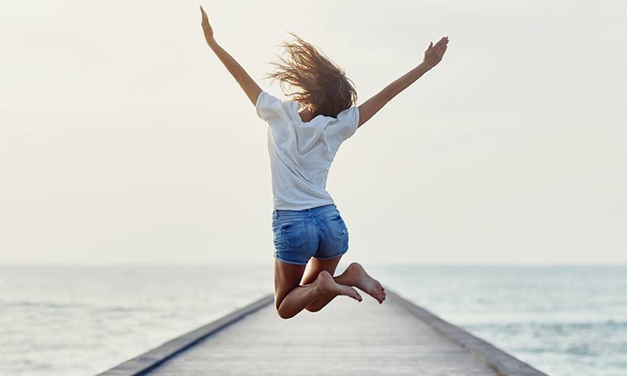
Leisure Time
psychological benefits of recreation activity
Enriched capa’bilities for team membership
Heightened creative ability
Improved expressions of and reflection on personal spiritual ideals

Slide 16
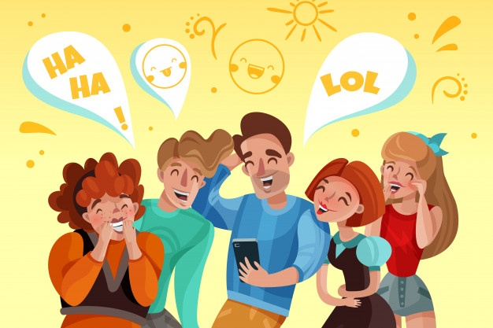
Leisure Time
psychological benefits of recreation activity
greater adapta’bility and re’siliency,
enhanced perceived quality of life,
better sense of humor,
enhanced perceived quality of life,

Slide 17
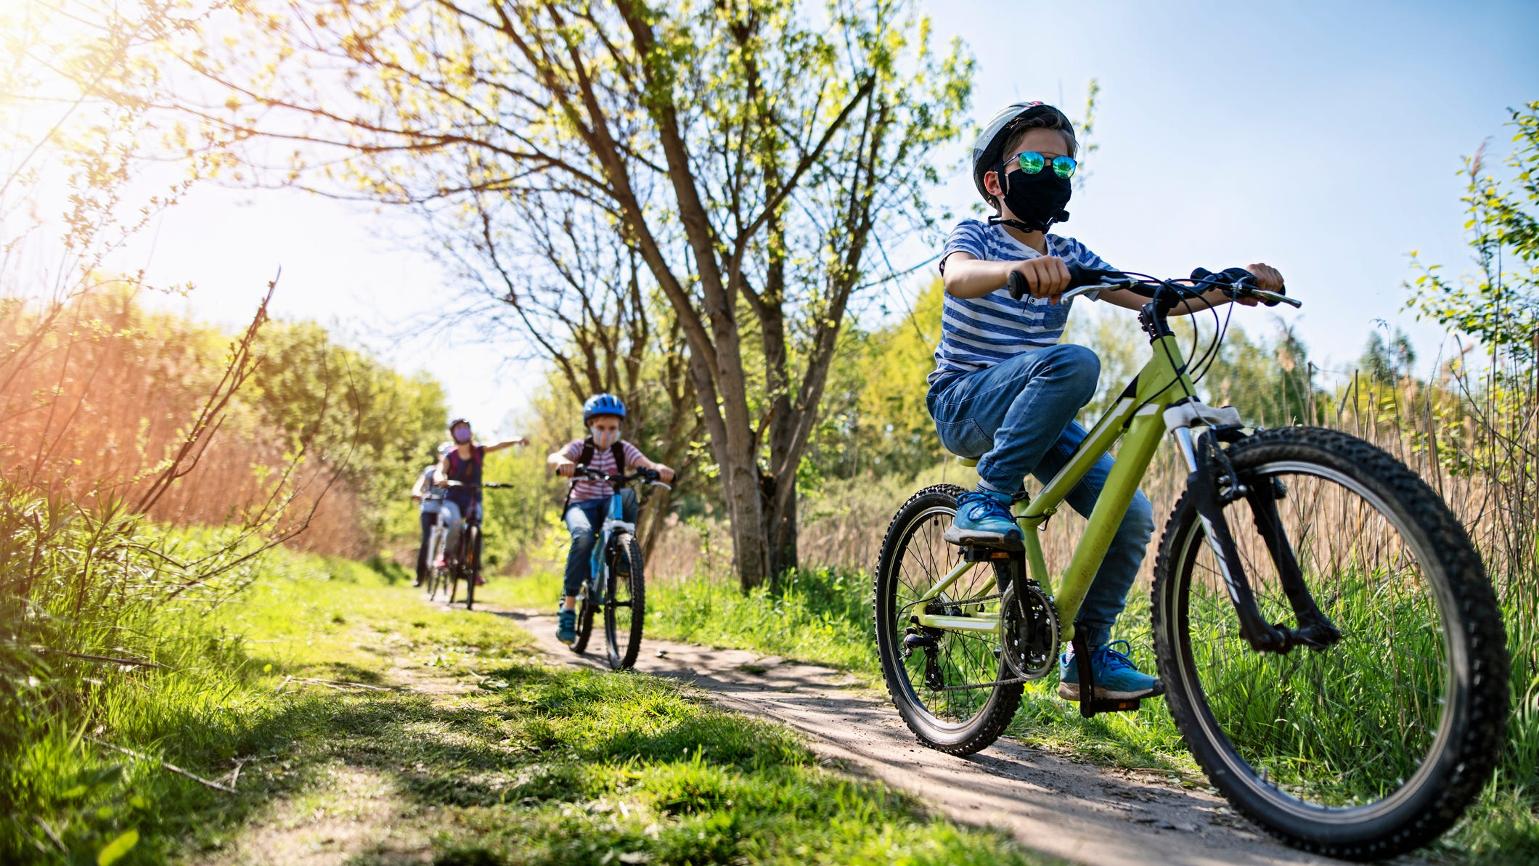
Leisure Time
Benefits of recreation participation
Involvement in recreation activities releases stress and tension from the perils (‘perols) of society.
Activities that fill leisure time, performed within a group, strengthen social support ties known to negate stress
One's environment can be a determinant to stress reduction. Natural environments can be pleasant, relaxing, and stress-reducing for many people, but large urban cities also provide the same experience.

Slide 18
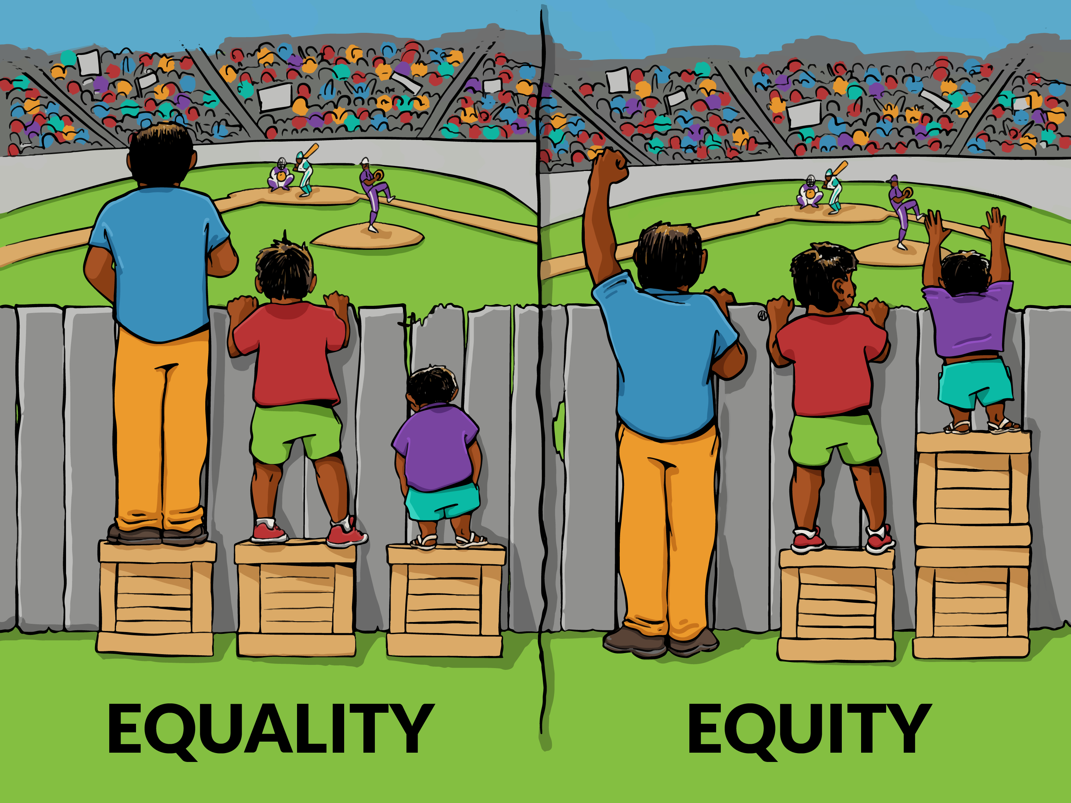
Leisure Time
Benefits of recreation participation
Leisure experiences promote opportunities for developing equity.
Unlike many other environments within which people interact, leisure experiences promote opportunities for everyone to maximize her or his own interests and minimize competition.
It is during leisure time when husbands and wives, and parents and children, are most apt to practice by negotiating family roles and reaching new definitions of consensuses.

Slide 19


Slide 20
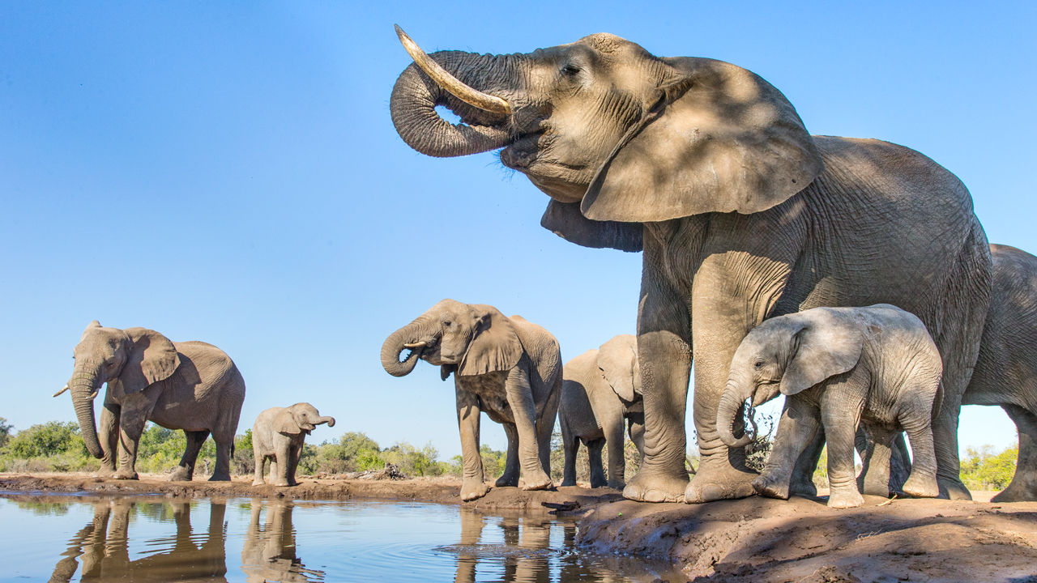
Exercise: matching the icons
directing visual memory
Benefits of activities in leisure time
1
2
learning from the experience
3
value learning
lower blood pressure levels
4
improving sense of self-worth
5
Creating Frustration
reducing resting heart rates
6
7
increasing lung capacity

Slide 21

Leisure Time
Things to do
Be an active volunteer:
One of the noblest, as well as productive ways to spend your free time, would be to volunteer for a local non-governmental organization.
If there is some cause which you feel strongly about then there would most certainly be a no better way for you to be spending your free time.

Slide 22
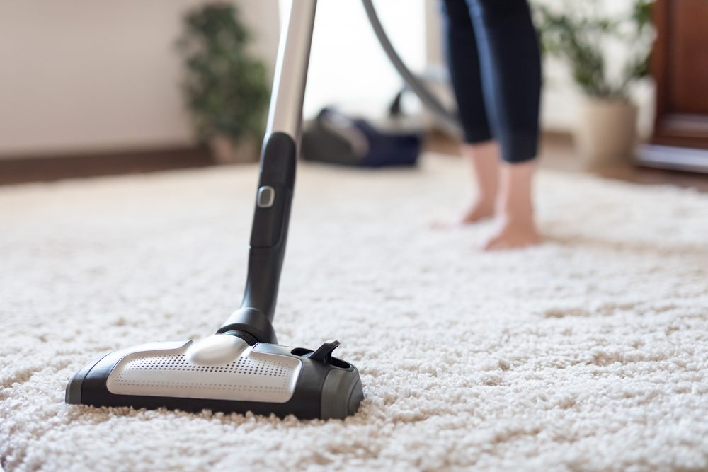
Leisure Time
Things to do
Settle your house:
The home is where the heart lies and in your spare time, you make it a point to settle your house and get various things in order. There is most certainly some truth in the common saying that “A clean home is a happy home” so rather than just throwing caution to the wind or spending hundreds on a housekeeper you could always get down to doing things on your own. If your house is well kept you will surely feel a great deal of pride and joy.

Slide 23
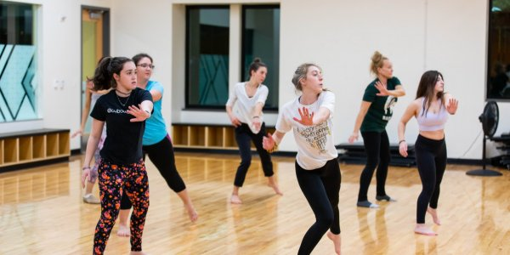
Leisure Time
Things to do
Sign up for a dance class:
Irrespective of whether you have two left feet or you are a great dancer, you should most certainly consider signing up for a dance class alone or with some of your close friends.
Often what people are unable to express through words they are able to express through the movements of their body.

Slide 24
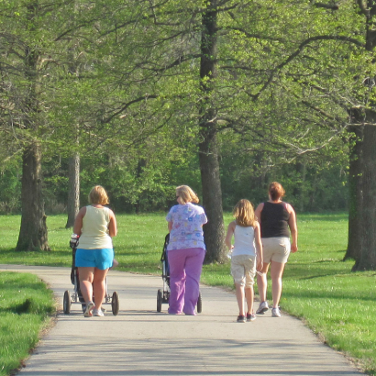
Leisure Time
Things to do
Go for a walk or a jog:
Rather than sitting at home doing nothing in your spare time, you could always consider going for a long walk or even a jog. Doing these two things will really help you gather your thoughts as well as keep healthy.

Slide 25
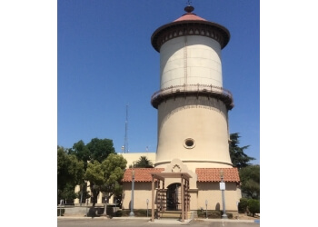
Leisure Time
Things to do
Visit some historical monuments (‘m):nu:mert) in your city:
One of the most productive ways to spend your free time would be going to visit some famous tourist attractions in your city that you have never visited before yourself.
In the process, you will not only appreciate your city more, but you will also learn a great deal about it.

Slide 26

Leisure Time
Things to do
Start a blog about something to do that interests you:
In today’s technological age there are innumerous people across the globe that spends their free time blogging.
Your blog could be on anything that interests you, whether it is cooking, sports, movies, societal problems or even books.

Slide 27

Leisure Time
Things to do
Read a good book:
If you are a bookworm then this is certainly something productive that you could do in your free time.
There are innumerable ways to get your hands on a good book, whether you take a walk to your nearest library, you borrow one from a dear friend or if you are a tech savvy person then you could simply download your book with the quick click of a button.

Slide 28
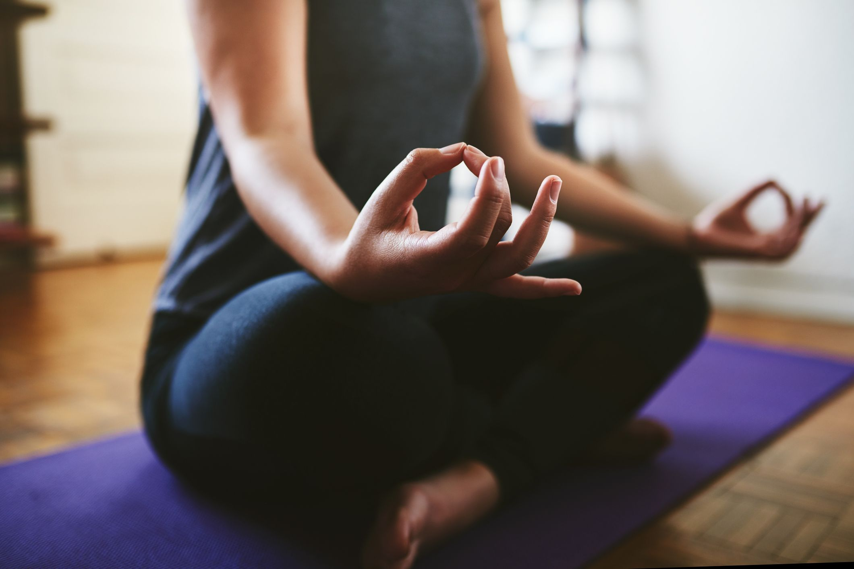
Leisure Time
Things to do
Meditate for a while:
Trying to survive in this modern world is tough indeed.
It is of paramount importance to spend at least a part of your free time in meditation to ensure that you do not crack under pressure and undergo a mental break down.

Slide 29
Leisure Time
Things to do
Watch a movie
When you have some free time one productive thing for you to do is watch a movie that has received several good reviews.
It is not necessary that you must head to the hall you could always download it and watch it from the comfort of your own home.

Slide 30


Slide 31
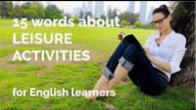

Slide 32
Leisure Time
Exercise:

